Slide 1

Group #18
OralOptix
INTELLIGENT ASSESSMENT OF INTRA-ORAL RADIOGRAPH QUALITY
Supervised By
Dr. Nahed Alowidi

Slide 2
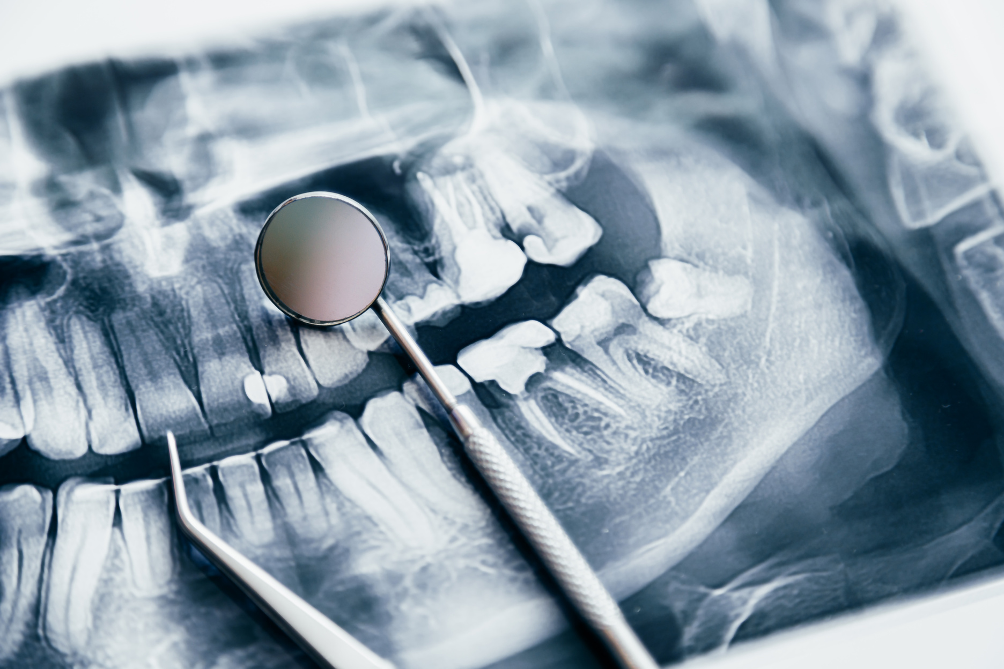



OralOptix
INTELLIGENT ASSESSMENT OF INTRA-ORAL RADIOGRAPH QUALITY
Problem Definition
manual assesment is :
time-
consuming
can lead to
inefficiencies
requires significant
expertise.

Slide 3







Objectives
Create a Database of Errors
Rapid Error Detection
Design a simple and effective user interface
Increase the level of diagnostic accuracy
Educational tool for dental students
Aims
The project aims to create an AI-based system that automatically assess the quality of radiographic images, whether they are accepted or rejected, depending on the acceptance of intra-oral radiographs standers. In addition, it identifies the common technical errors, such as incorrect positioning, inappropriate density and contrast, and scanner-related issues.
10cm

Slide 4

Target users
Dentist
dental Hygienists
Oral Sergeons
Dental Students

Slide 5


MOTIVATION
Healthcare Improvements in Saudi Arabia
Better outcomes, fewer complications
Reduces human error, improves accuracy
Impact
More efficient healthcare, reduced costs, better outcomes
Decreased redundant radiographic exposures, improving diagnostic efficiency and patient safety.
Vision 2030 Alignment
Supporting Vision 2030’s focus on promoting preventive care, reducing medical errors, and utilizing advanced technologies to improve healthcare outcomes in Saudi Arabia.
10cm

Slide 6
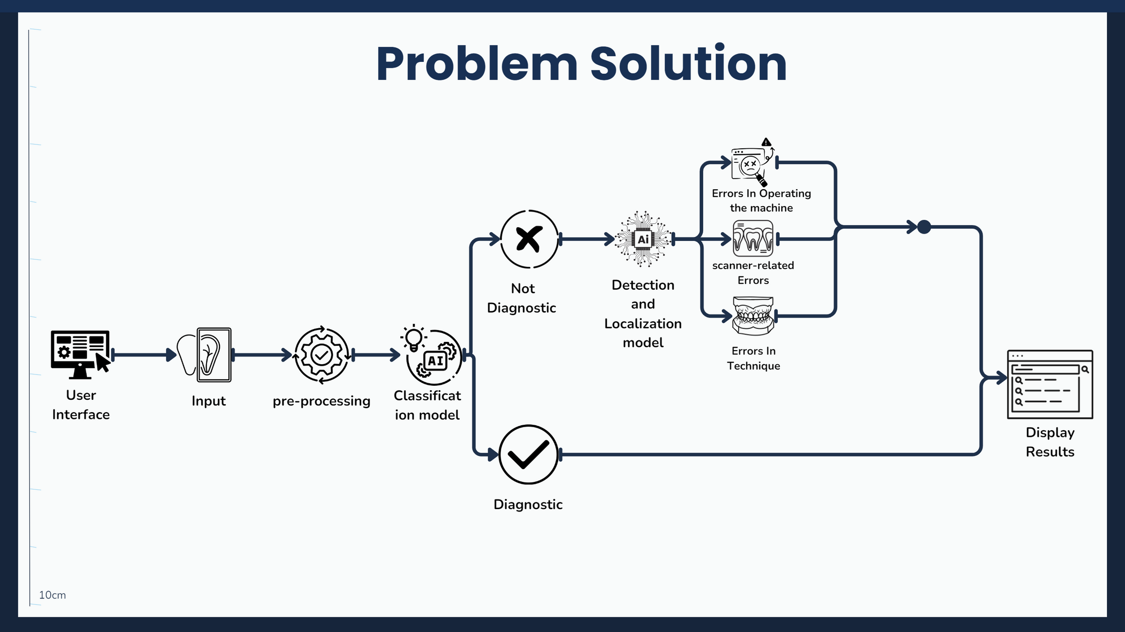

Slide 7


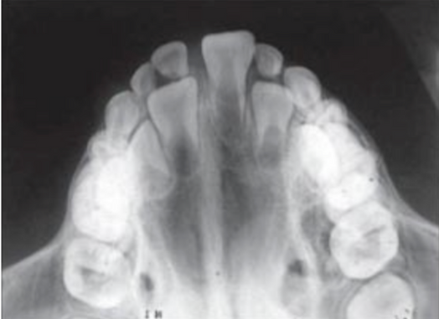
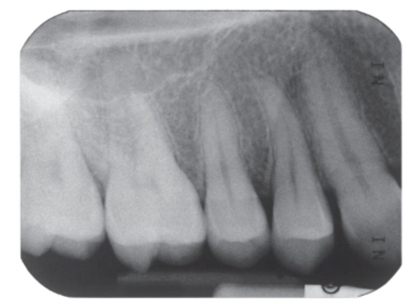
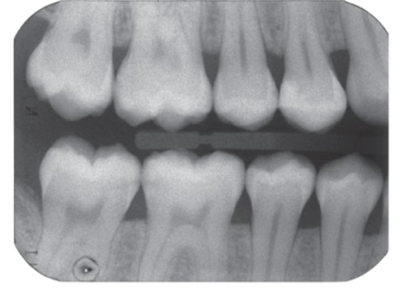

Medical Background
Intraoral X-Rays
Occlusal
Periapical
Bitewing
10cm

Slide 8

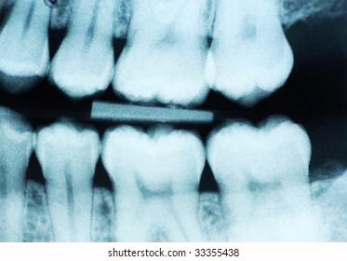

SCOPE
The scope of "OralOptix" is dedicated to improving Bitewing X-rays, a specific type of dental X-ray essential for viewing areas between teeth that aren't visible during standard exams. These X-rays are vital for detecting cavities and monitoring bone health.
10cm

Slide 9
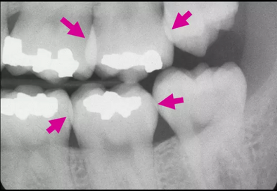
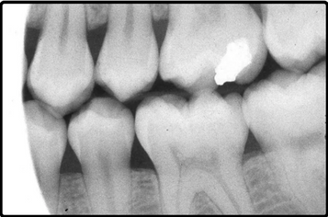
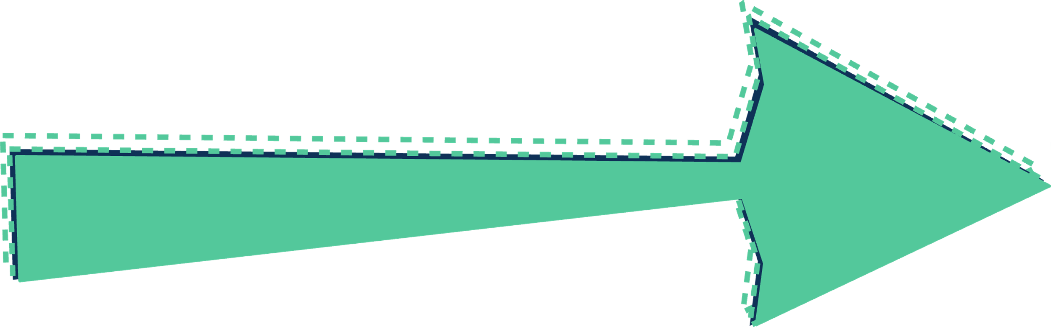


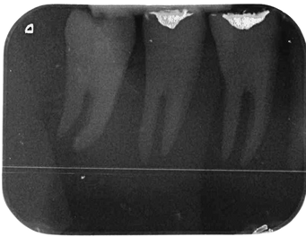
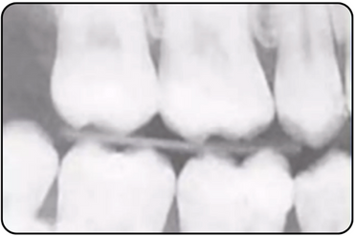

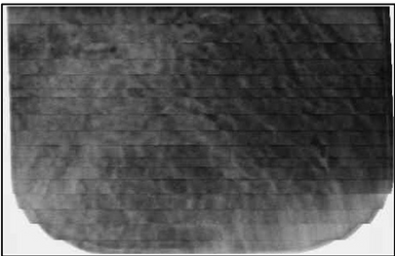
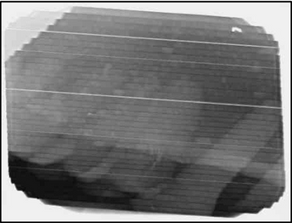

Medical Background
Common Errors in Bitewing Radiographs
ERRORS IN TECHNIQUE
ERRORS IN OPERATING THE MACHINE
SCANNER RELATED ERROR

Slide 10
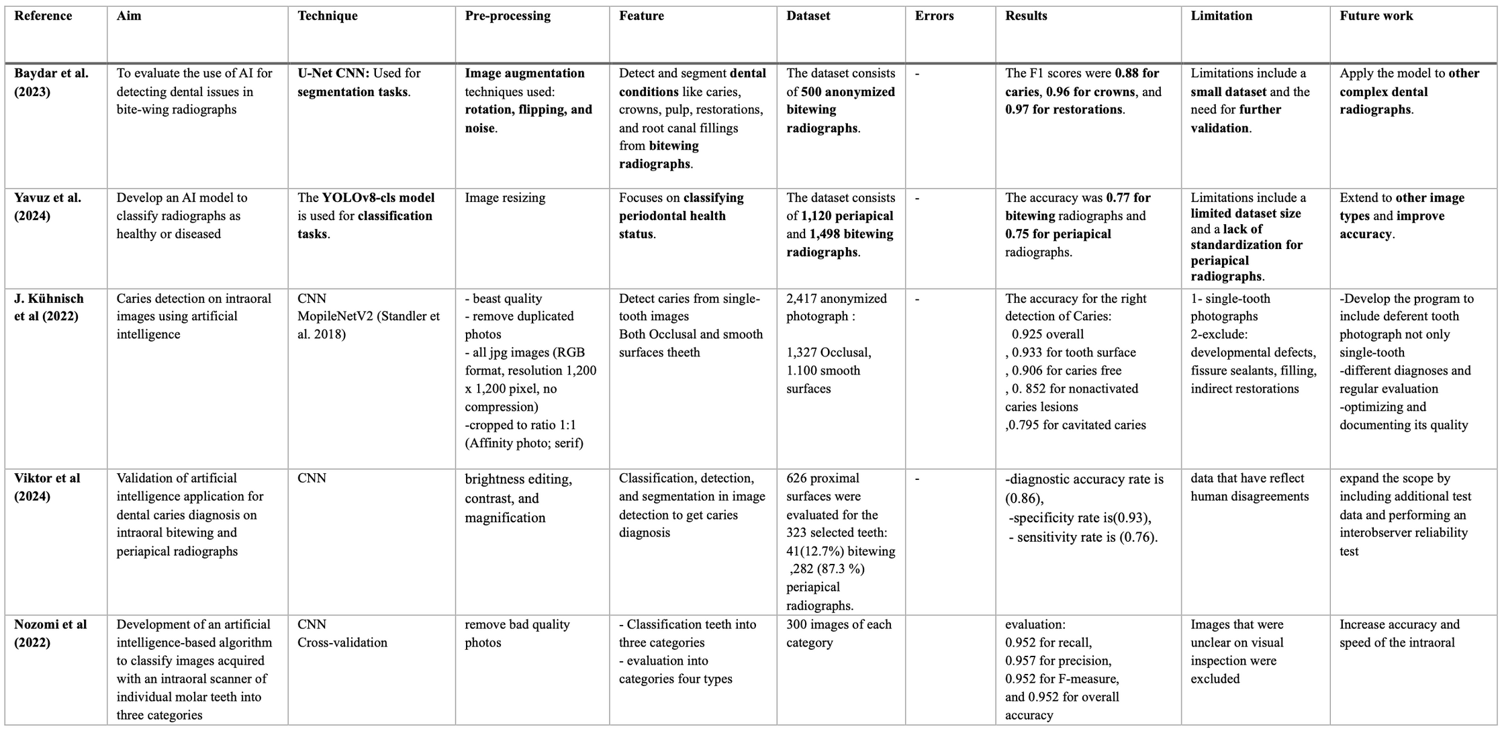
RELATED WORK
Intelligent Diagnostic Analysis of Bitewing Radiographs - Related Works

Slide 11
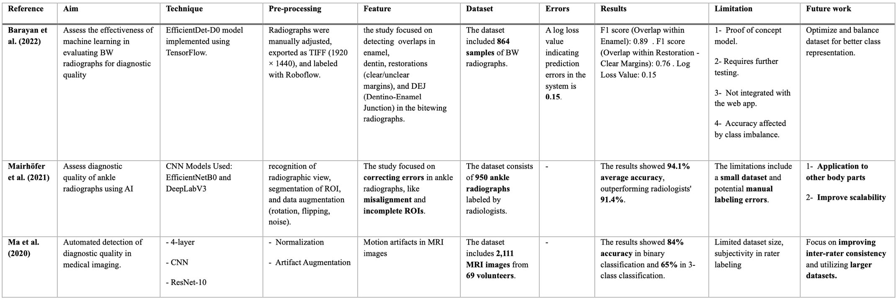
RELATED WORK
Intelligent Assessment of Bitewing Radiographs - Related Works

Slide 12
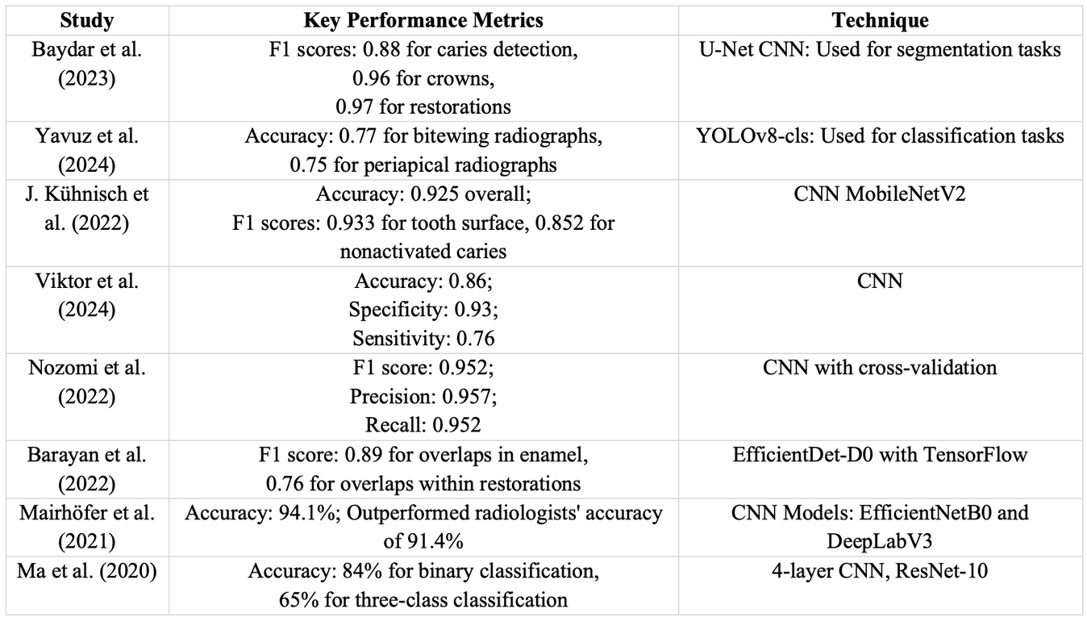
RELATED WORK
Comparative Analysis of AI Model Performance: Key Metrics and Best Performing Techniques
Highlights of the Best Performing Models:
Baydar et al. (2023): The U-Net CNN achieved the highest F1 score (0.97) for segmenting restorations, making it the top performer for segmentation tasks.
Mairhöfer et al. (2021): The combination of EfficientNetB0 and DeepLabV3 models showed the highest overall accuracy (94.1%) for error correction in ankle radiographs.
Nozomi et al. (2022): CNN with cross-validation excelled in classification tasks, achieving an F1 score of 0.952.

Slide 13

Data Gathering:
In an interview, Dr. Najla Neamatalla Turkestani, an Assistant Professor in the Department of Restorative and Esthetic Dentistry, explained that checking bitewing radiographs by hand takes a lot of time and can lead to mistakes, especially with less experienced dental students; she recommended an automated system to improve accuracy, lower patient X-ray exposure, and enhance overall patient care and satisfaction.
Interview

Slide 14
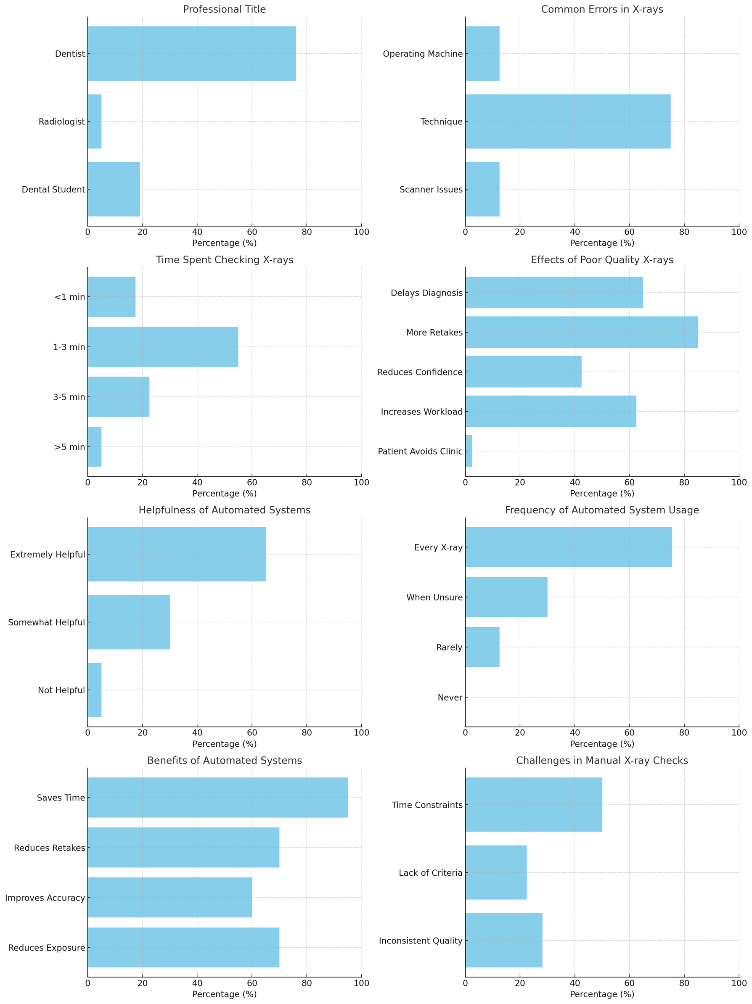
Questionnaire

Slide 15
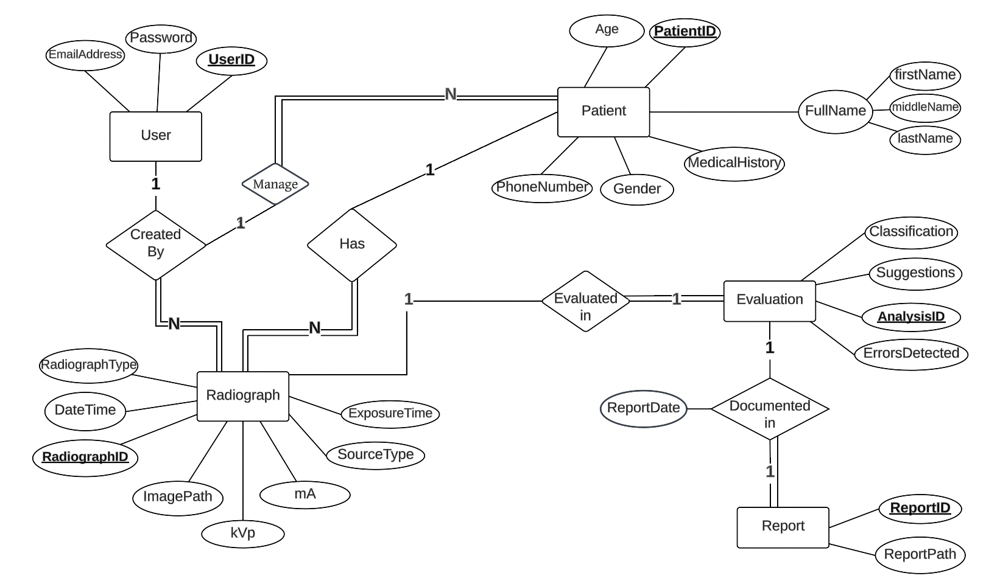
The Entity Relationship Diagram

Slide 16
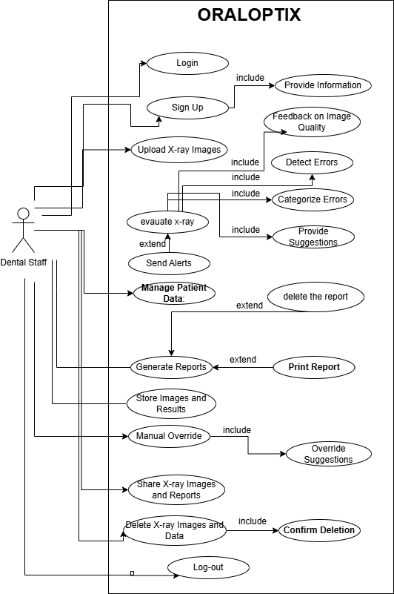
Use-Case Diagram

Slide 17
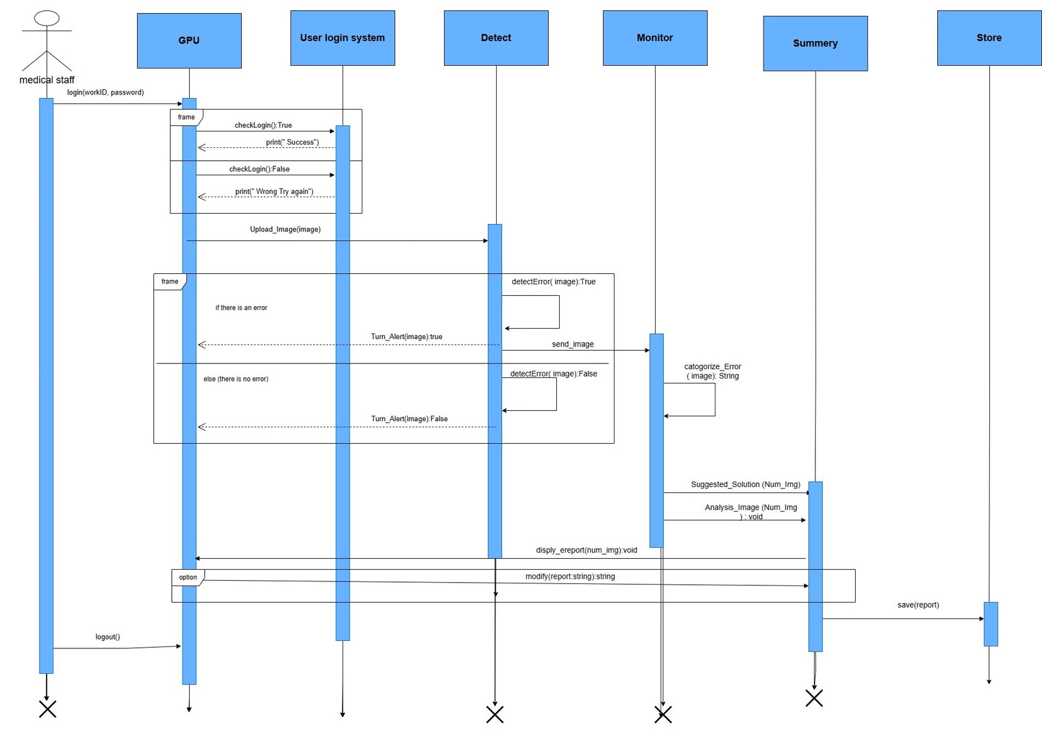
Sequence
Diagram
medical
Staff

Slide 18
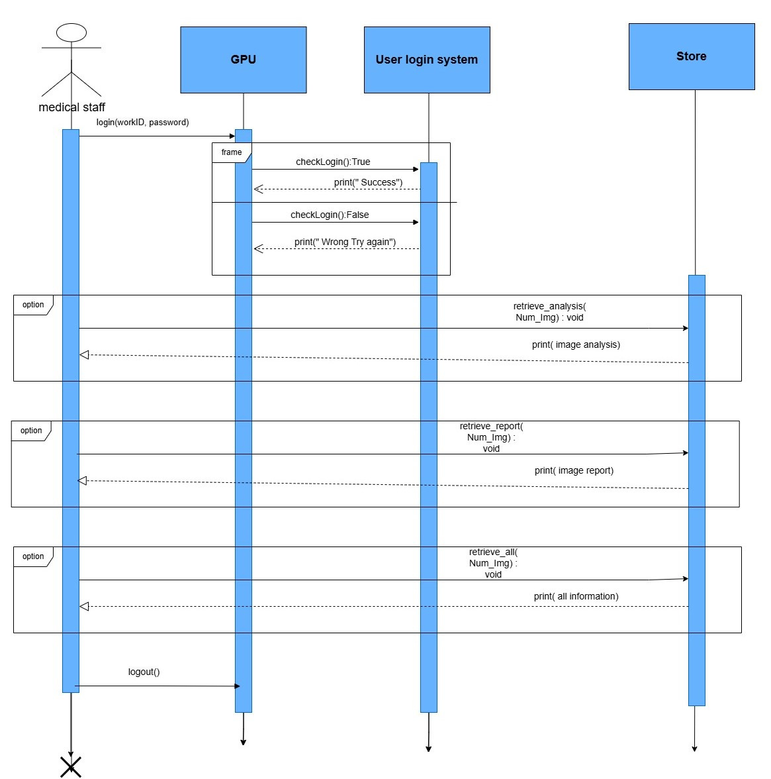
Sequence Diagram
retrieve stored information

Slide 19
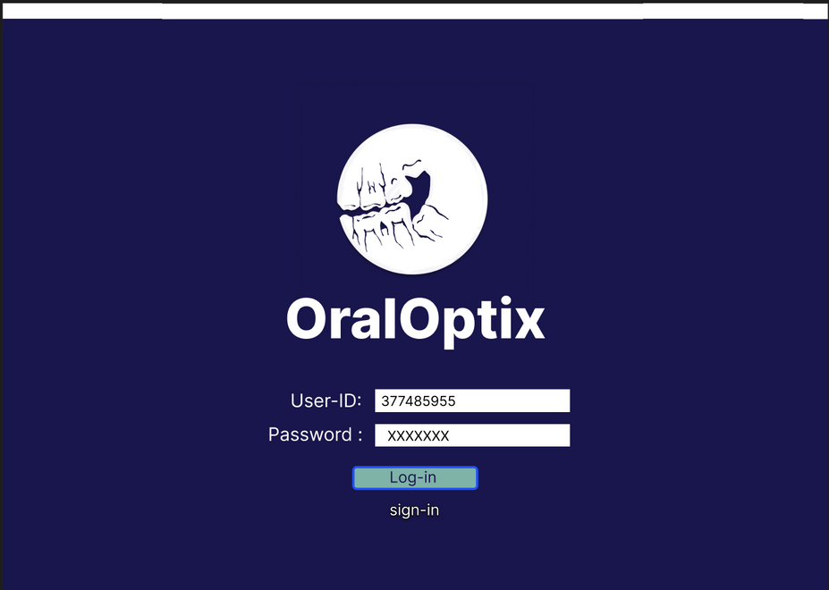
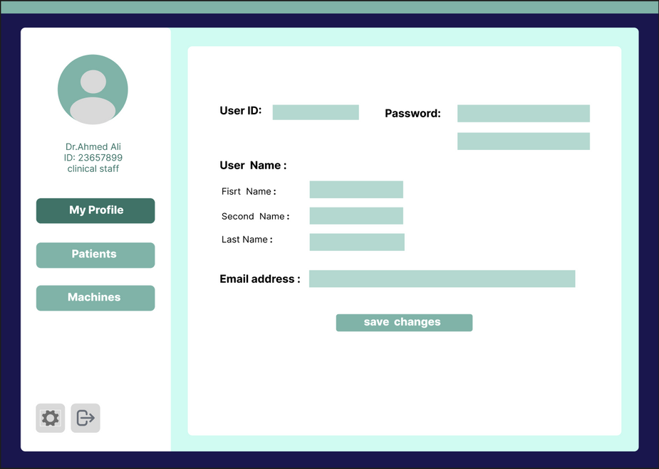
Functional Requirements (FR)
FR.1: The system shall allow authorized dental staff to log in and out securely.
FR.3: The system shall require dental staff to provide relevant information
FR.2:The system shall allow dental staff to sign up for an account.

Slide 20
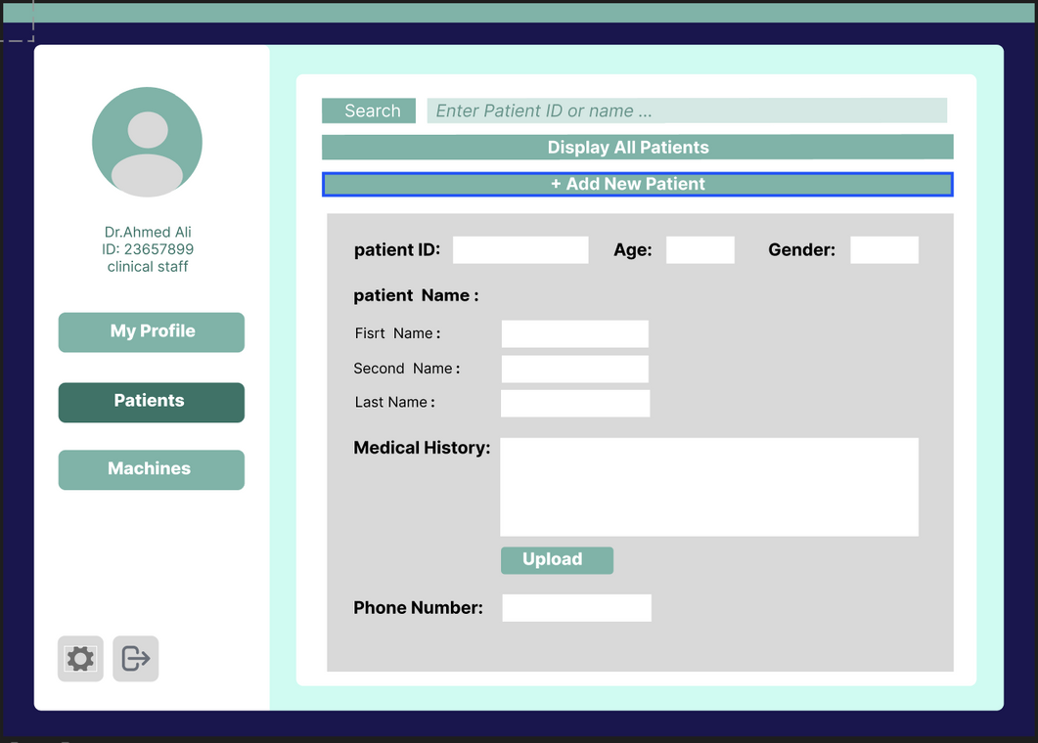
Functional Requirements (FR)
FR.4:The system shall allow users to input and manage patient data

Slide 21

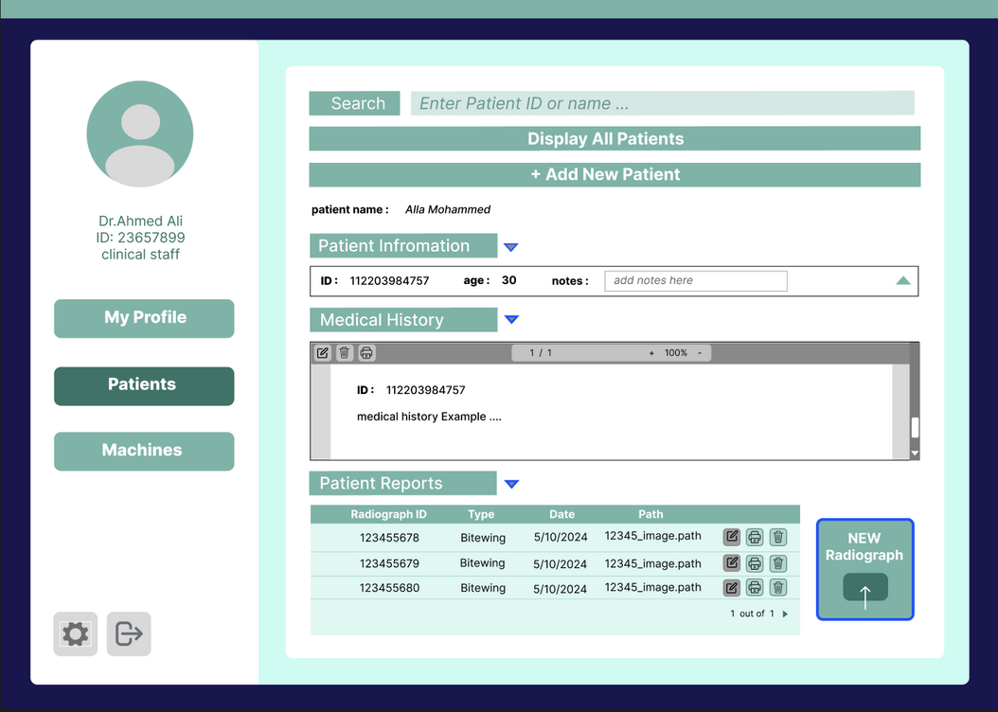

Functional Requirements (FR)
FR.5: The system shall support manual override by the user.
FR.6.: The system shall allow users to input and manage radiograph details
FR.7:The system shall allow users to print X-ray images and quality assessment
reports.
FR.8:The system shall store all captured images and their analysis results in a
secure database.

Slide 22
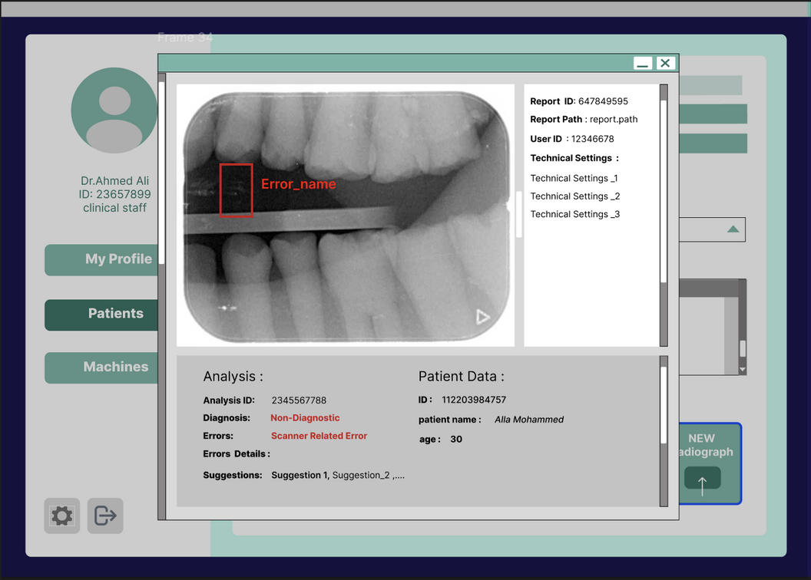
Functional Requirements (FR)
FR.9: The system shall detect errors .
FR.10: Categorization of errors into machine operation errors, technique errors, and scanning errors.
FR.11: The system shall provide corrective suggestions to the technician to adjust the X-ray positioning or other parameters before exposure.
FR.12: The system shall generate detailed analysis reports for each radiograph image.

Slide 23
Non-Functional Requirements
NFR.1: The system should respond within an acceptable timeframe
NFR.2: The system should support the English language.
NFR.3:The system should be available to all users 24/7.
NFR.4: The system shall ensure data security and privacy.
NFR.5: The system must provide a user-friendly interface.

Slide 24
Thanks
Do you have any questions ?

